Slide 1
Local Government Development:
Municipal Services
Dr. Hatem ELKADI
Government Services Delivery Program Director
Ministry of State for Administrative Development
hkadi@ad.gov.eg

Slide 2
Government Services
e-Services
  Central Gov. Services
  Access channels
  e-Identification
  e-Payment
Local Government
  Municipal services
  Investors Services
  Local Portals
  …

Slide 3
Egypt - Oerview
Area: total: 1,001,450 sq km
Population:77,505,756 (July 2005 est.)
Religions: Muslim 94%, Coptic Christian and other 6%
Languages: Arabic (official), (English and French)
Capital: Cairo
Administrative divisions: 26 governorates
GDP per capita: purchasing power parity - $4,200 (2004 est.)
GDP - composition by sector: agriculture: 17.2%, industry: 33%, services: 49.8% (2004 est.)

Slide 4
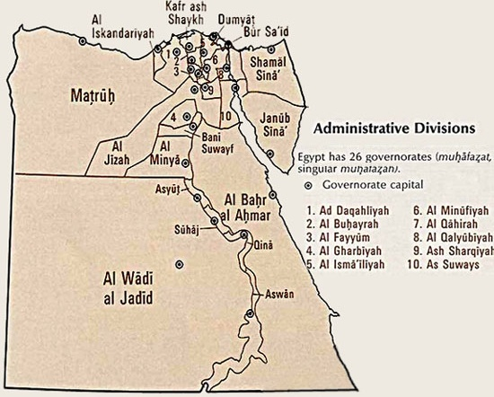
State Composition
central hydraulic society
Built around the Nile
26 Governorates
  287 Cities & Districts
    5000 Villages
Limited Administrative autonomy
Governors Appointed

Slide 5
Local Government

Slide 6
Rationale
Local government unit is the closest governmental entity to the public
Worldwide approach
Problems are less acute and better controlled
Higher interaction with the public
“Productizable”

Slide 7
Objective
Better serve the public through management enhancement using ICT
  Reduce the service delivery time
  Better service environment
  Better monitoring & control for better transparency and equity
  Through
    Business Processes enhancement
    Automation (ICT)
    Training & Capacity Building

Slide 8
Problems
Weak Control
Corruption
Messy environment
Lack of indicators

Slide 9
City Council
Organization Structure
Decision Support
External Services
Internal Services
MIS / ERP

Slide 10
Municipality Services
Internal
Building permits
Commercial/industrial license
Low cost housing
Real Estate Taxation
Street Advertisement permits
Street works permits

Slide 11
Municipality Services
External
Education
Health
Social Security
Labor
…

Slide 12


Citizen Service Center
Conceptual Framework
Front Desk
Citizen Service Center
DSS
Back Office
Security
Dept
Dept 3
Dept 2
Dept 1
Dept
رخص
البناء
مكتب
الرسم
التحصيل
الاملاك
الاميرية
رسوم
التفتيش
Dept
مكتب
الحفر
Dept
ادارى
المرافق
الايجارات
الجبانات
Dept
الاملاك
المصاعد
الفنادق
والملاهى
Dept
التحقيقات

Slide 13
Municipality Project Model
Municipality
Top
Mgmt
Information
Center
Citizen
Service
Dpts

Slide 14
Project Components
1- Services Automation
Identification of Citizen Services
Analysis of existing Business functions and processes
Identify possible re-engineering areas
Model the different workflows
Develop application

Slide 15
Project Components
2- Personnel / Training
Basic training for all users:
  Computer literacy
  Typing
  Basic Office packages
Training of application users
Advanced training on OS / DBMS / LAN administration
Advance training on application administration
Training on new business functions

Slide 16
Project Components
3- Procedures Modifications
Identify bottlenecks in existing/modified procedures
Modify procedure
Implement reviewed procedure
Monitor and assess change and impact

Slide 17
Project Components
4- ICT Infrastructure
Identify workflows steps
Identify computers needs (Clients & Servers).
Identify LAN/WAN needs
Supply and install computers/licenses
Install LAN/WAN cabling and Active Components

Slide 18
Project Components
5- Civil Works
Identify suitable area for Citizen Service Center (CSC)
Modify Architecture for CSC
Furnish CSC with suitable facility
Modernize Information Center premises
Renovate most of building administrative offices

Slide 19
Scope of Work
$1.3Mo | 6 + 1 Sites Renovation, remodeling, extending, … | Civil Works Including Electrical Network
 | Desks, Seats, Meeting tables, … | Furniture
 | ~420 PCs, Printers,… Queuing System | ICT Equipment
 | ~600 outlets ~20kms CAT 5 FTP cables | LAN’s
 | 67 Workflows >500 Application Screens | Business Applications
 | 354 Trainees, 28500 Hours Applications Training | Training

Slide 20
Results

Slide 21
Results – (1)
ٍShrinking of Accumulated Files
Identification of congestion areas and recommend solutions
Reduce service delivery time
Accumulative Build up of business databases

Slide 22
Results – (2)
Detailed documentation of business processes
ِAvailing a method and tool for performance measurement
Obtaining preliminary performance measures
Obtaining actual statistics of different services provision

Slide 23
Results – (3)
Standardizing workflows among similar departments in different municipalities
Identifying a number of procedures to be modified
Finding solutions for long queues
Review of specific legislative issues to be modified

Slide 24
Number of Requests (1)

Slide 25
Number of Requests (2)

Slide 26
Change in Delivery Time (6/6)

Slide 27
Change in
Delivery Time Variance

Slide 28
Scope of Development

Slide 29
Business Areas
Governorate Quarters
Local Parliament
ٍSocial Society
Affiliate agencies
Service Dpts
Investment Planning
City Councils

Slide 30
Activities
DSS
GIS
EIS
Services
Portal
MIS
Intranet

Slide 31
GIS
Integration with Services
      Building Permits
      Street Ad’s and works
      ...
Investment Planning Dpt.
      Industrial zones, Touristic areas
Decision Support
      Education, Tourism, …

Slide 32


Governorate Portal
Cooperation with other project
Standard unified interface ready for roll out
Features
  Information about Governorate and its divisions
  Governorate news
  Information about services
  Links to Online Services

Slide 33
Thank you …

